Slide 1
PROJECT
https://fontsvilla.com/

Slide 2
𝕀𝕟𝕥𝕣𝕠𝕕𝕦𝕔𝕥𝕚𝕠𝕟 𝕆𝕗 ℙ𝕣𝕠𝕛𝕖𝕔𝕥
Enter your text into Fontsvilla Fancy text generator to generate cool and fancy fonts.
Scroll through an extensive list of combinations and select a Fancy font type that resonates with your vision.

Slide 3
SCOPE OF THE PROJECT
Vast collection of fonts
Categories for easy navigation
User-friendly interface
Copy fonts style and paste everywhere it.

Slide 4


Fonts Categories
Glitch
Small
Twitter
Cursed
Instagram
Bold
Cursive
italic

Slide 5
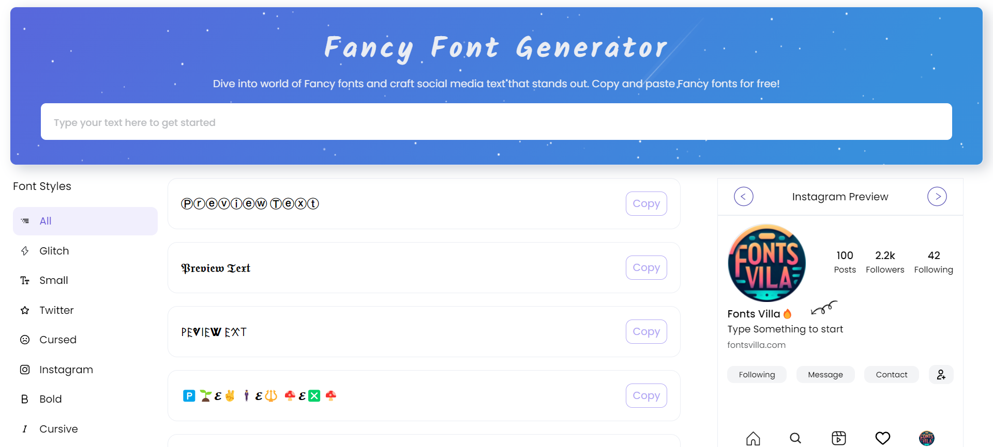
Website Home Page

Slide 6
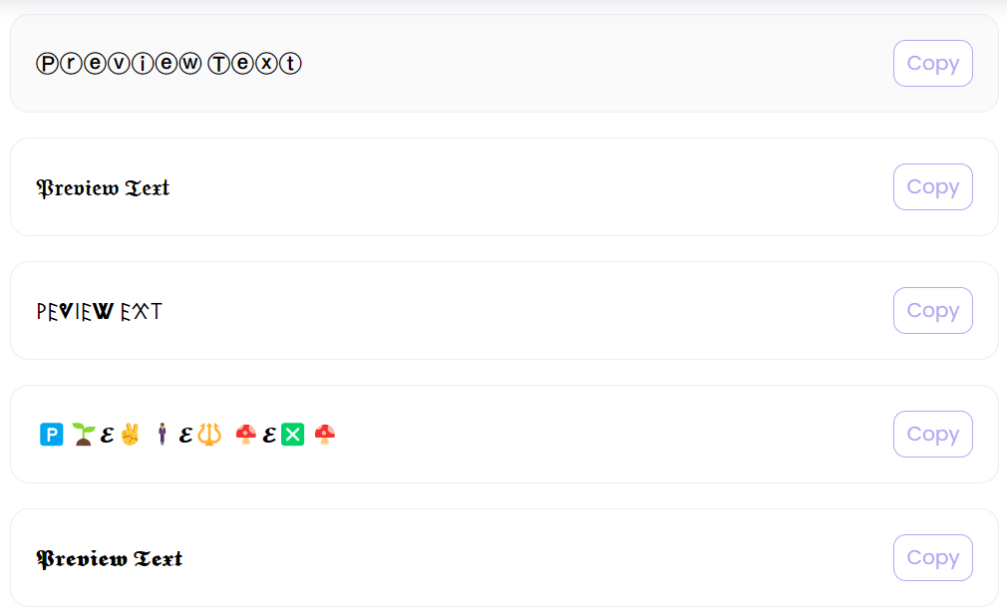
Fonts Preview

Slide 7
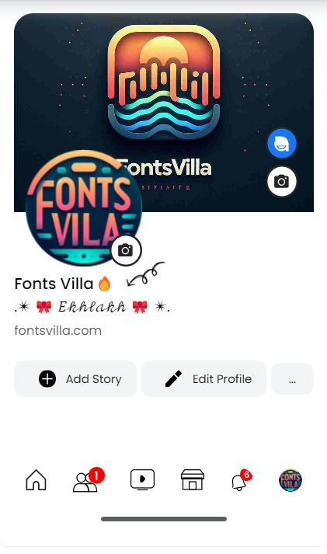
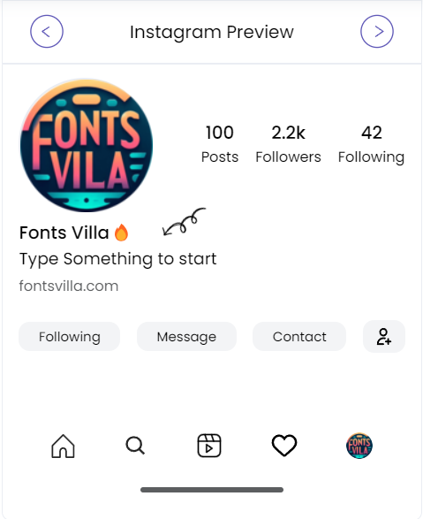
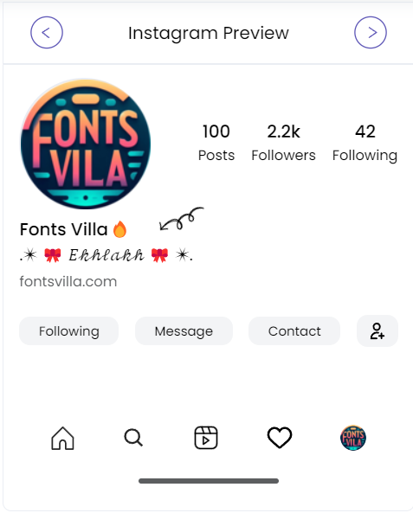
Fonts use in Social media profile

Slide 8
Thank You

